Slide 1
₵ry $ecure
DON’T CRY…..
BE SECURE!

Slide 2


Slide 4
What is unique to ₵ry $ecure?

Slide 5


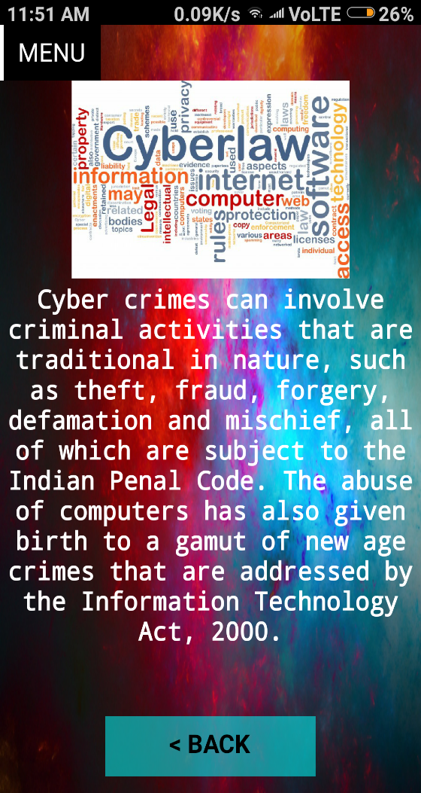


Features of the app
Learn all things to keep yourself safe from cyber threats

Slide 6

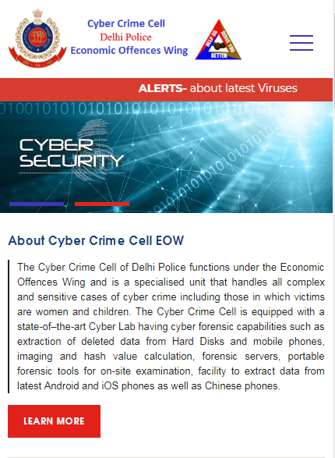
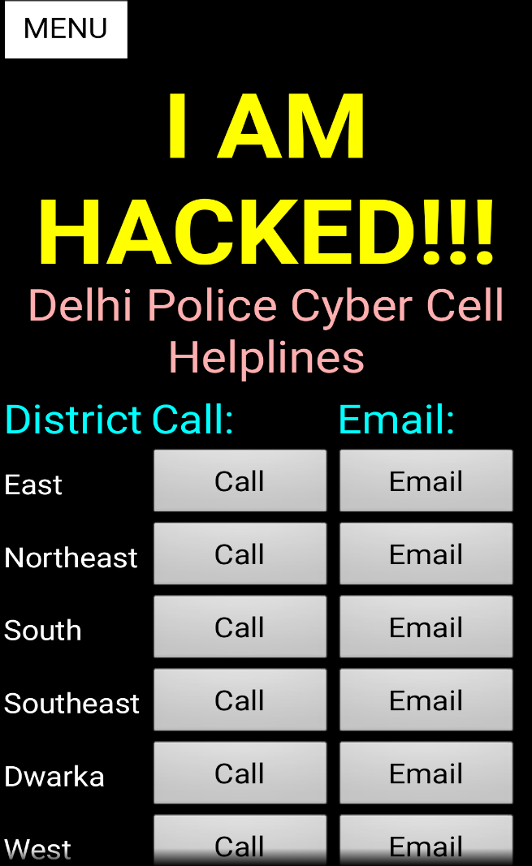
Features of the app
Got hacked? Call the Cyber Crime Cell of Delhi police!

Slide 7

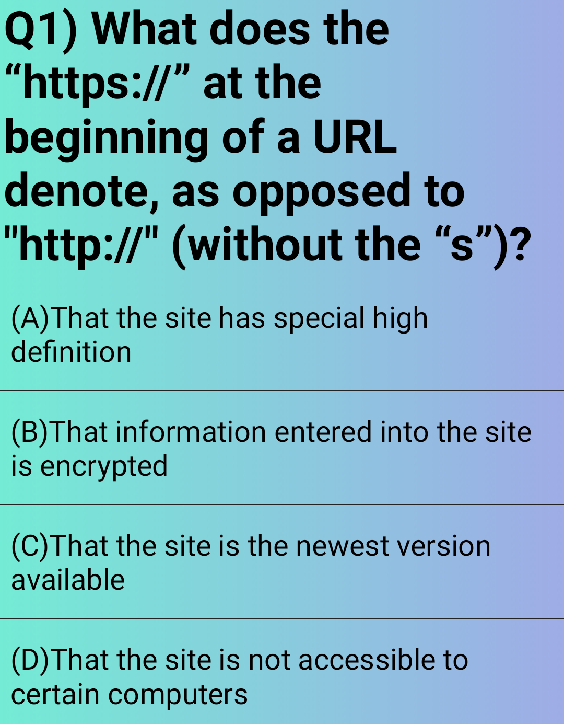
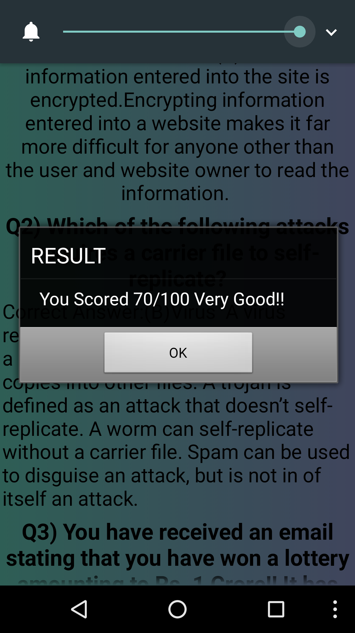
Features of the app
Take a quiz to evaluate your learning.

Slide 8
MOTIVE
Notes:
Our main motive behind making this app is to make people aware of the various threats they are exposed to on the online world, and how to deal with them.

Slide 9
Thanks for watching!

